Slide 1
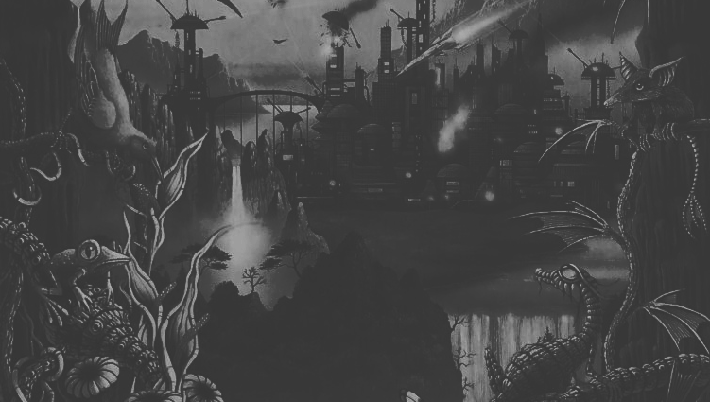
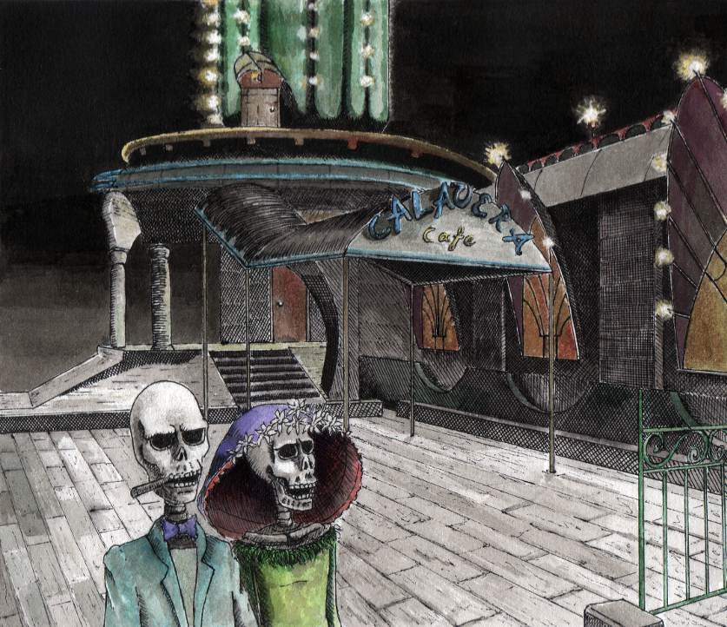
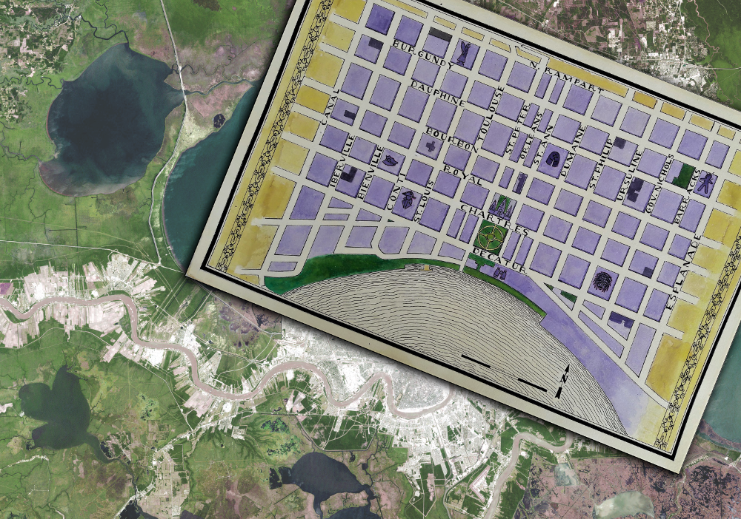
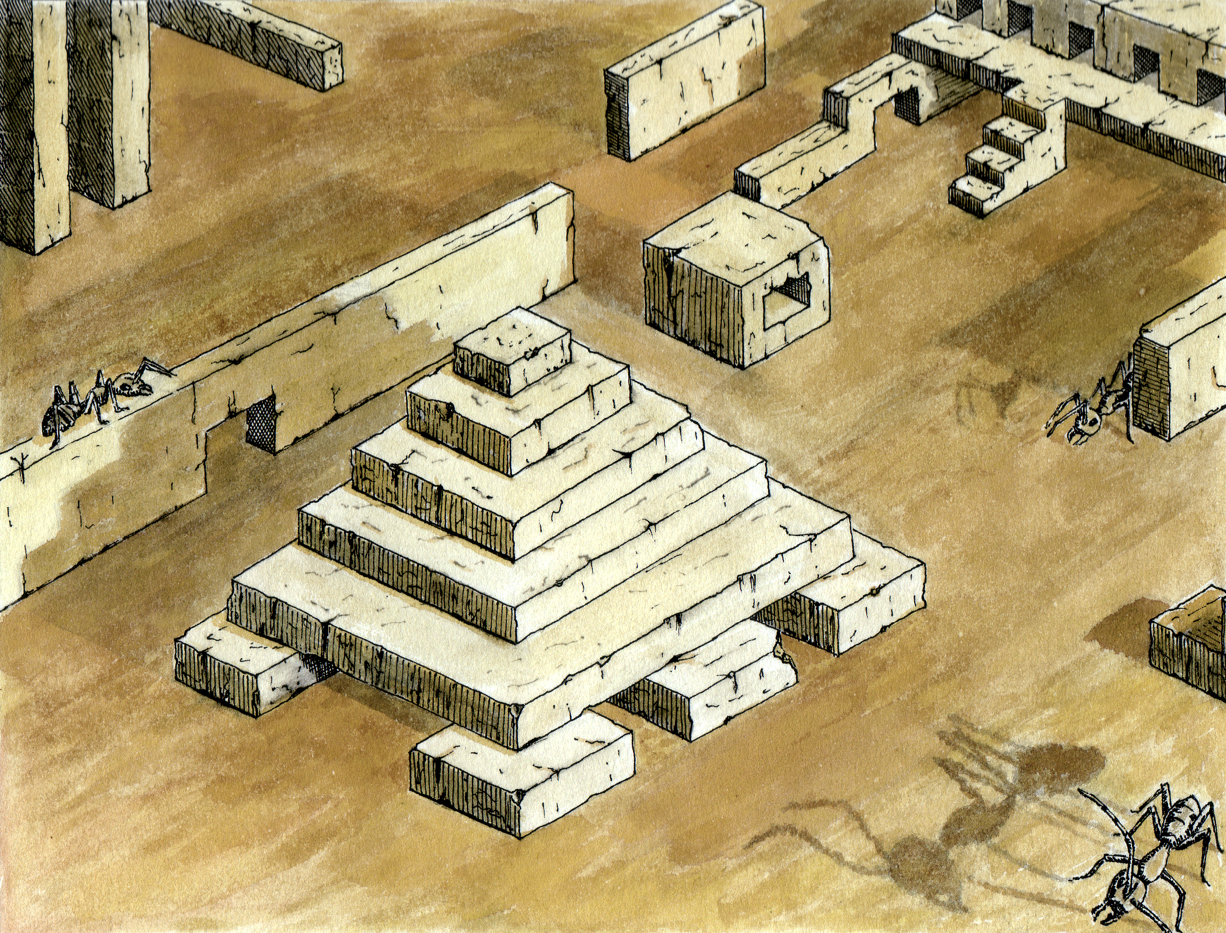
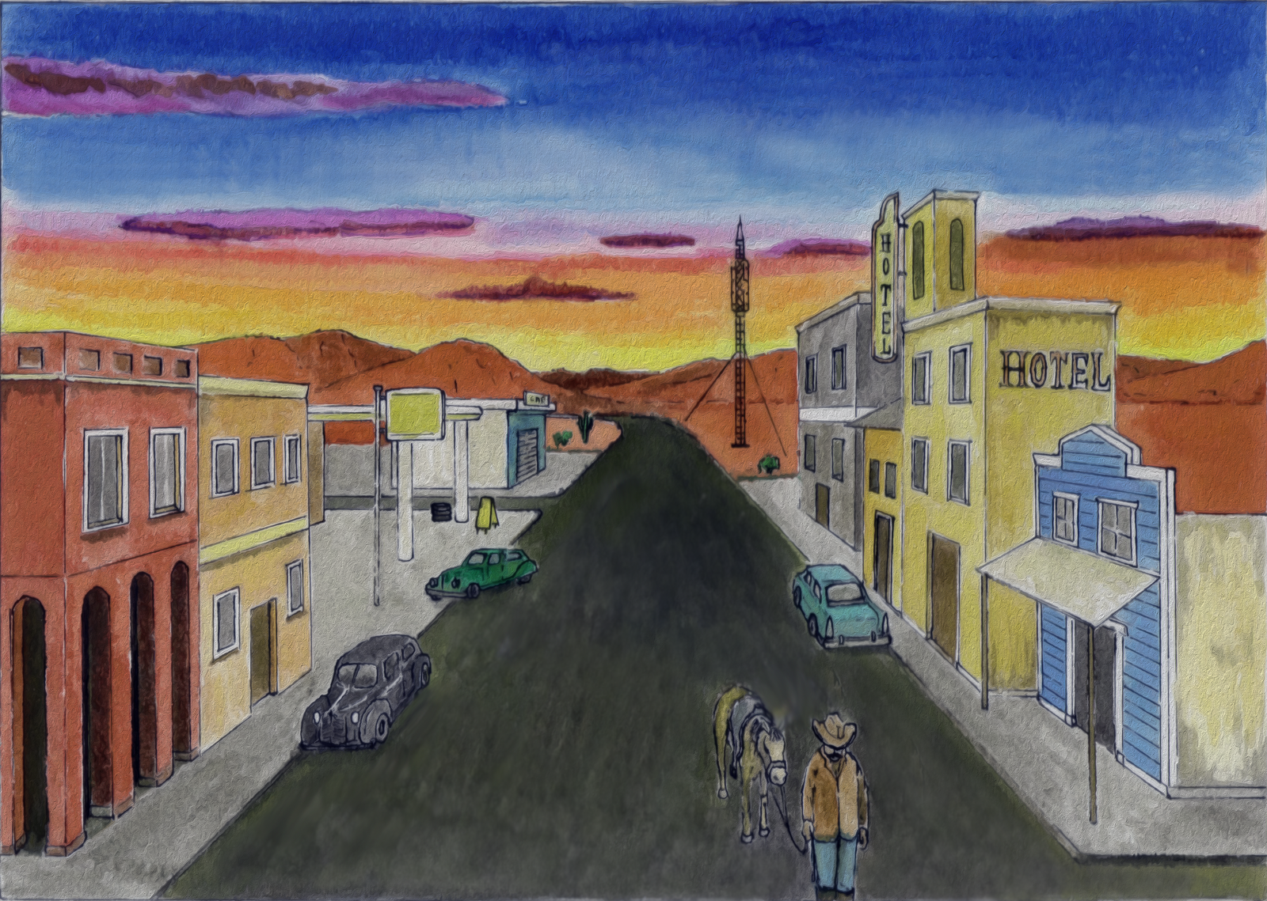
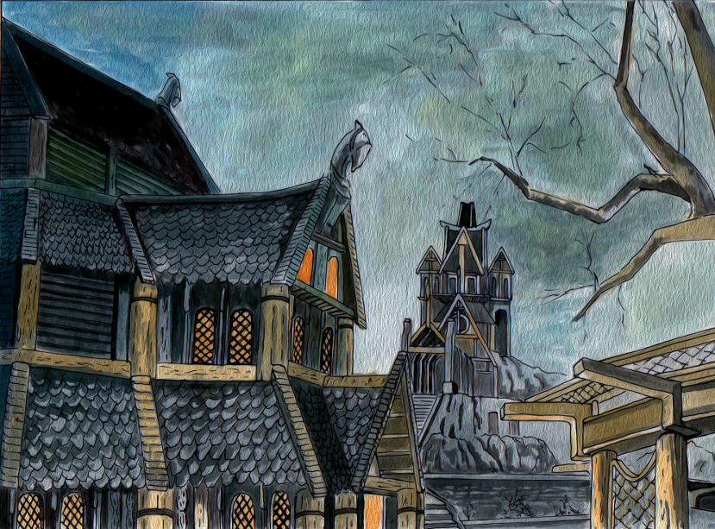
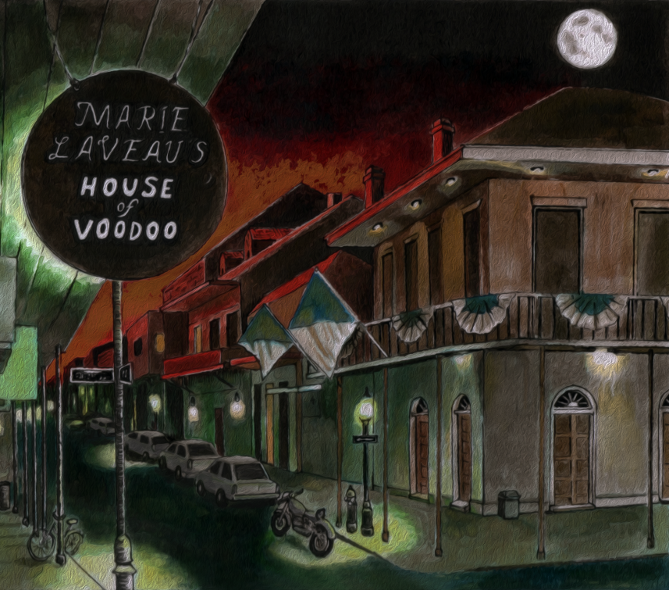
Playing With the Building Blocks of Utopia
Konstantinos Dimopoulos

Slide 2
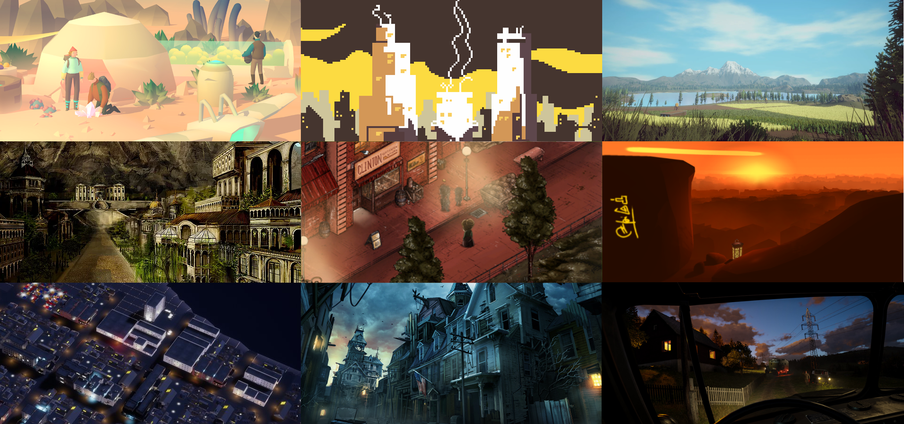

Slide 3
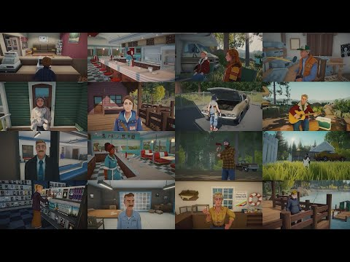
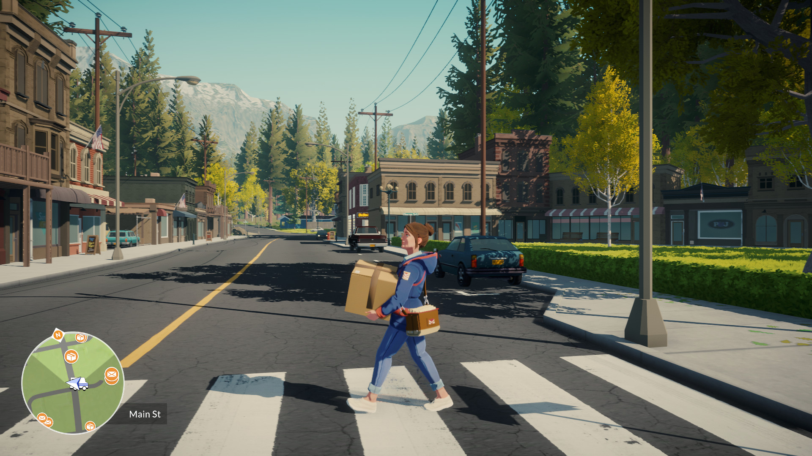

Slide 5
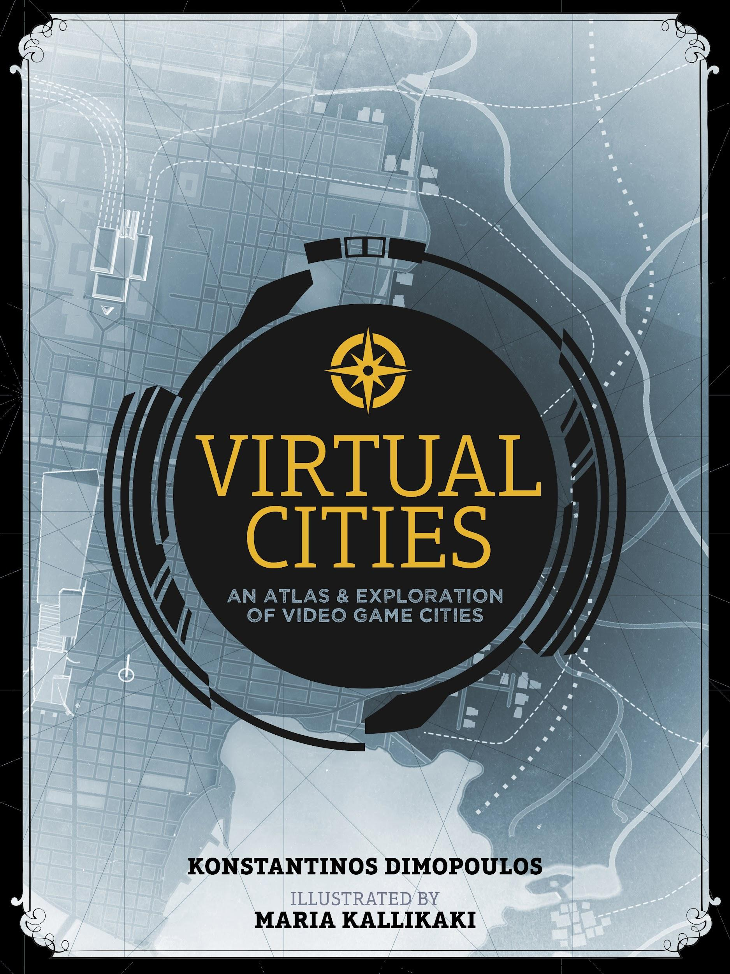
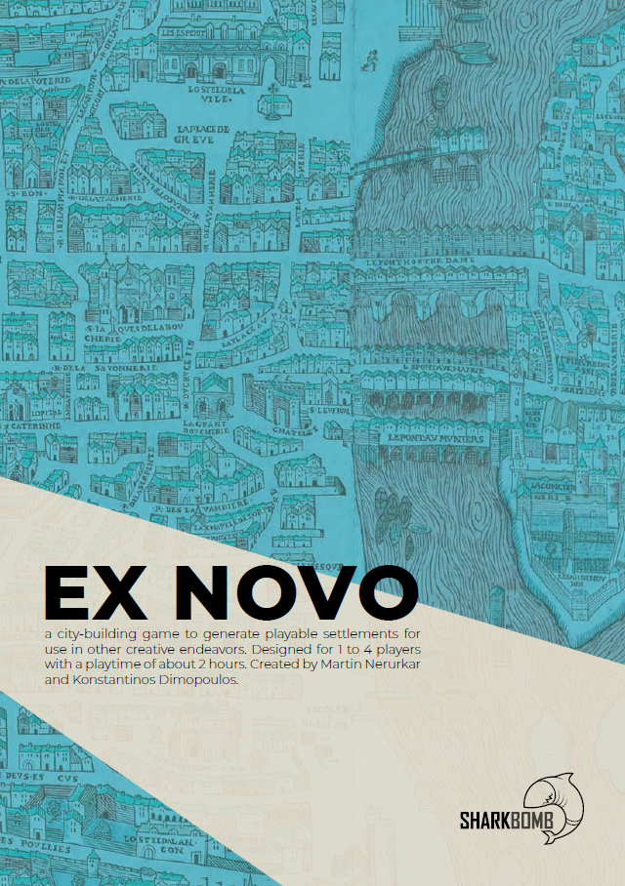
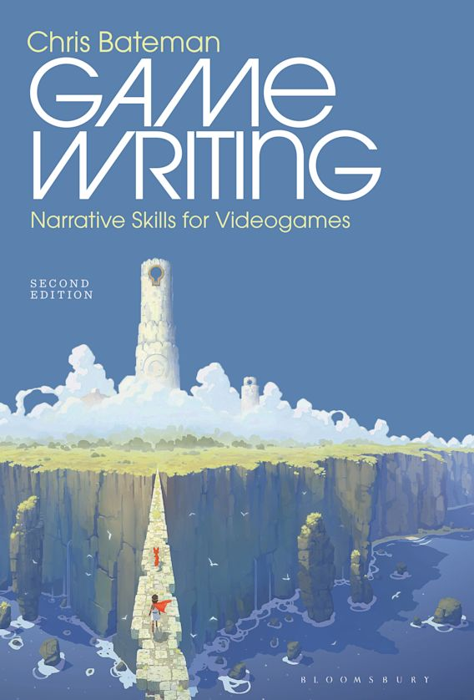

Slide 6
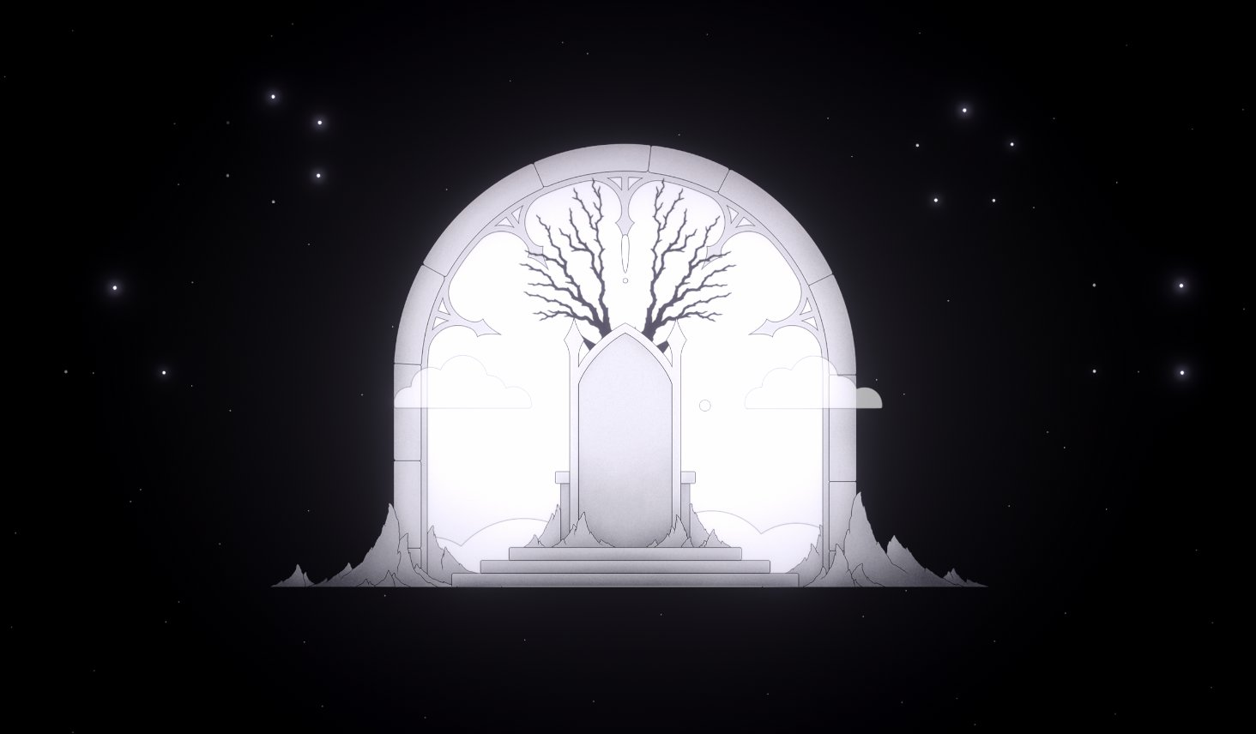
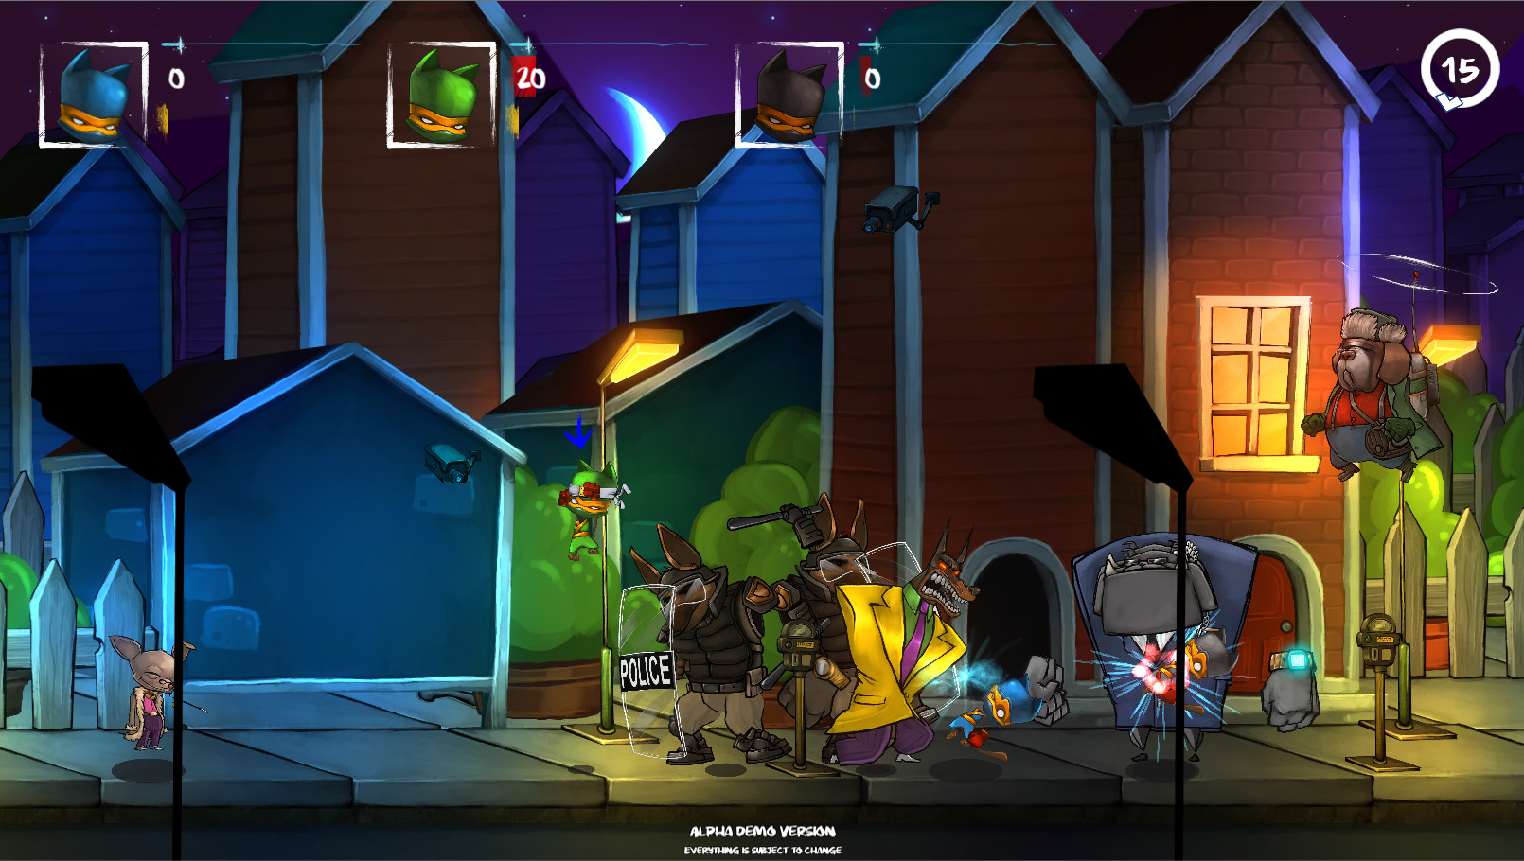
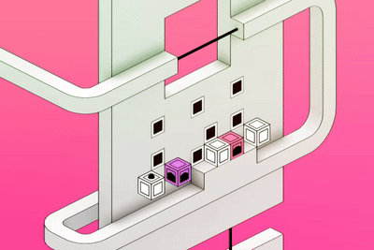
Game Development in Greece

Slide 7
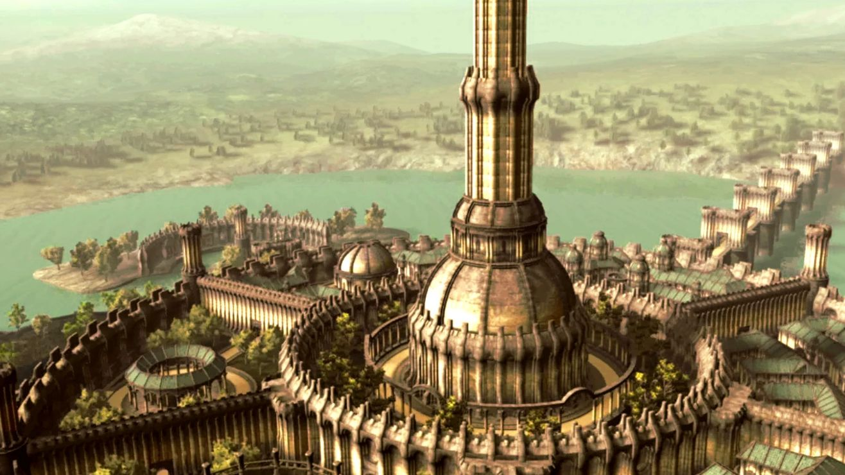
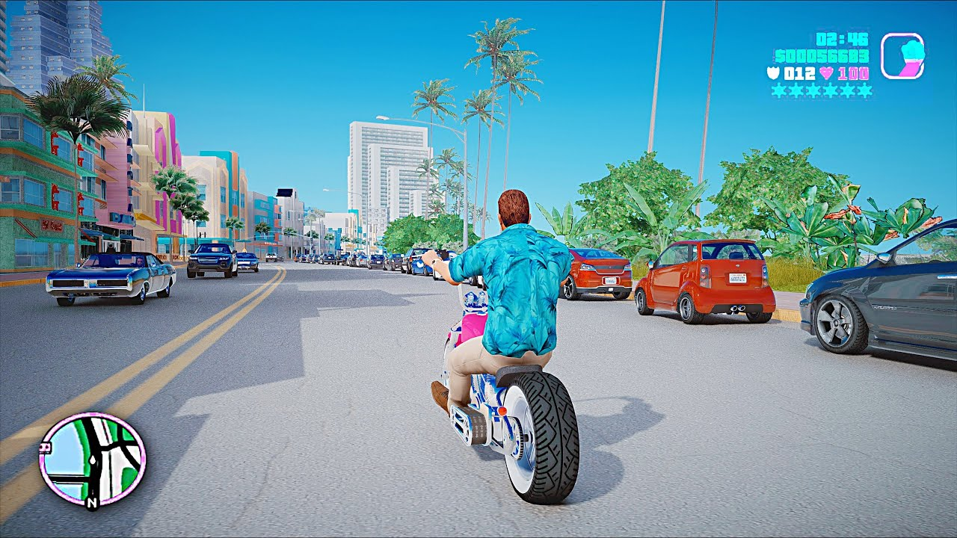
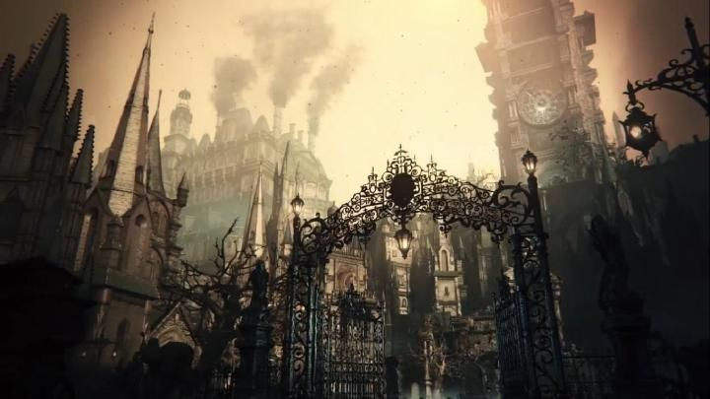
What does a game urbanist do?
Designs the urban structure, environments and systems of games.
Steals from real-life urbanism, engineering, and architecture.
Applies level and game design to urban environments.
Simulates civic life and societies.
Abstracts heavily.
Engages in world building, and crafts histories.
Creates (or imagines) civic concepts.
Stylizes existing or historical cities. Builds imaginary virtual cities.
Wonders on the interplay of real and digital urban spaces.

Slide 8
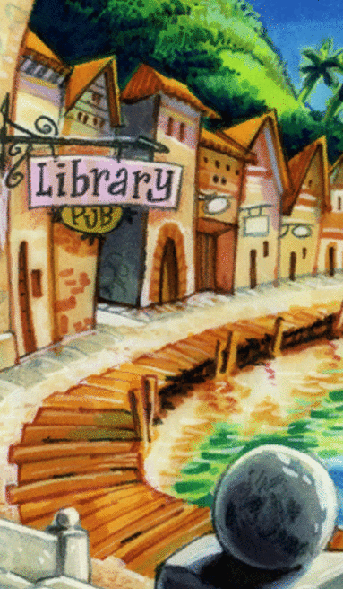
And what are gaming’s virtual cities?
All cities and all urban environments found in games.
Hopefully believable illusions.
Game spaces to be approached via level & game design.
Simulations (up to a point at least).
Narrative actors, and diegetic scenery.
Pithy showcases of world-building.
Incredibly varied.
Stages for gameplay and storytelling.
Complex configurations that need to be made legible.

Slide 9
Before discussing utopia, dystopia, and the video game city, a look at utopia and urbanism.

Slide 10
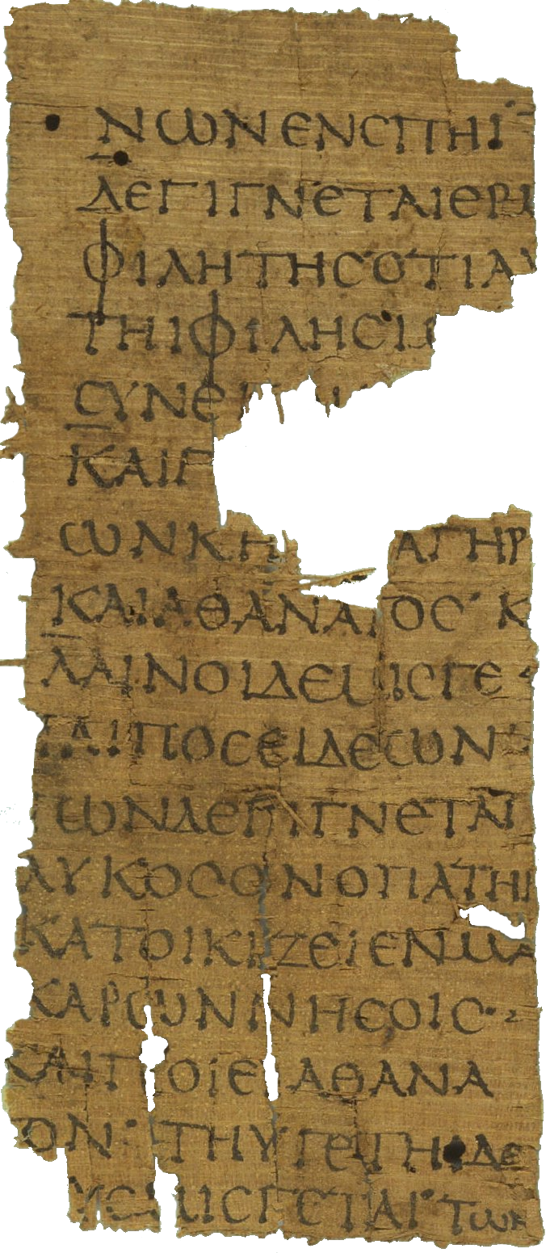
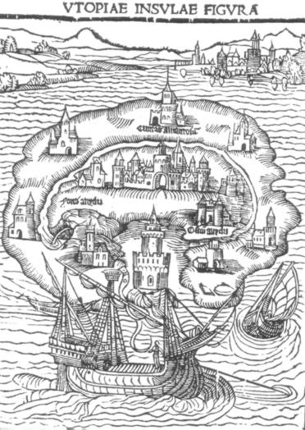
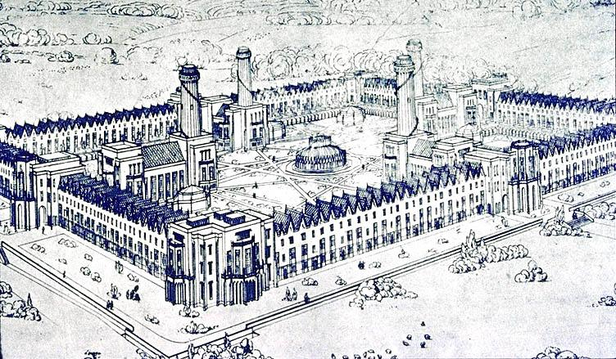
Utopia and Urbanism
Utopia does not necessarily have to be urban, but historically it has been predominantly expressed via imaginary cities.
Utopian thought and hopeful political programs do not have to be expressed spatially, but doing so makes them easier to imagine. Makes them feel more achievable.

Slide 11
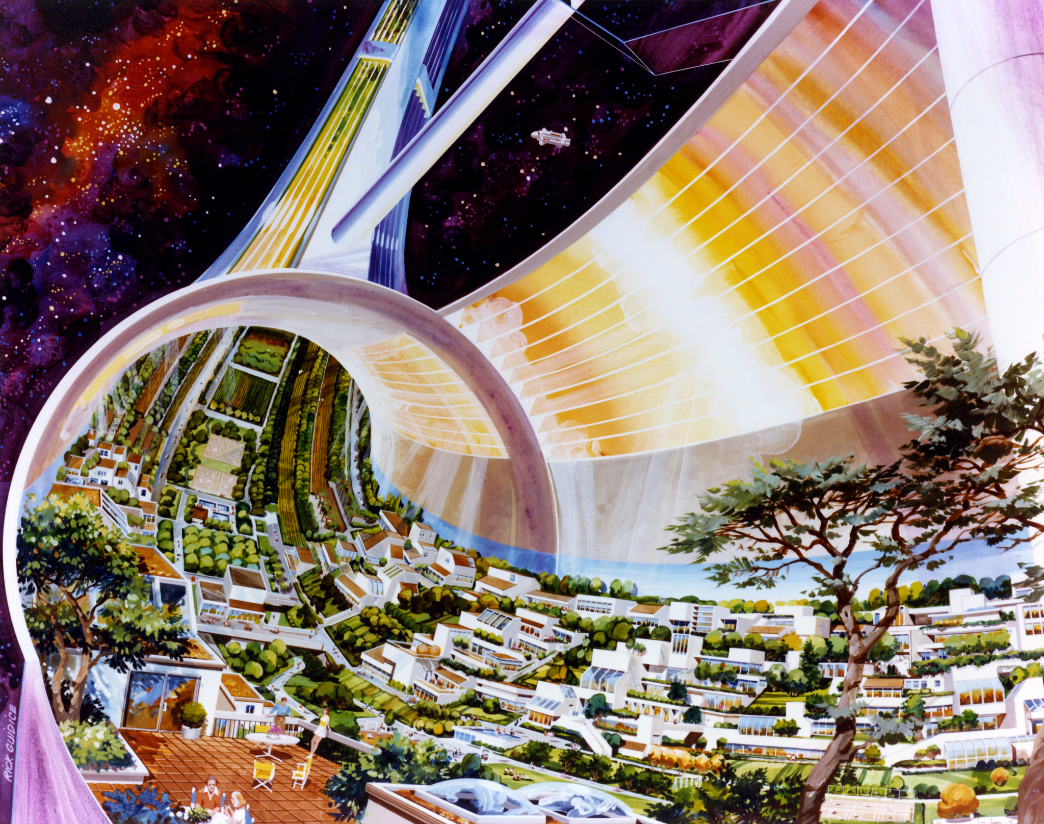
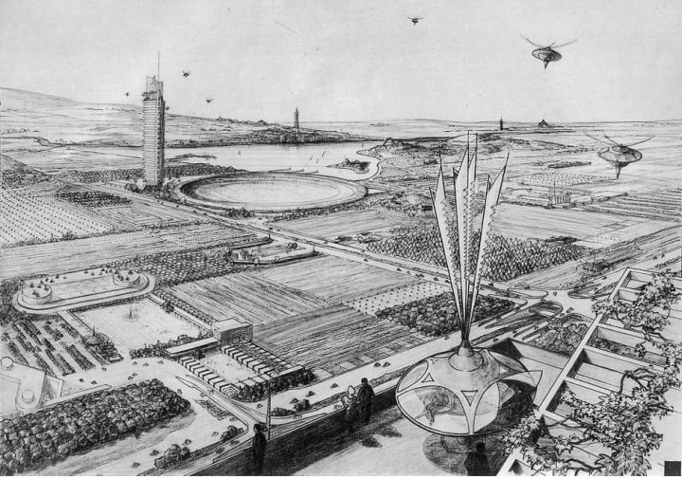
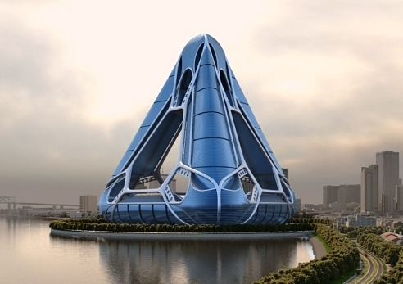
Utopia becomes political when people are actually able to imagine it. Imagining places and societies that do not yet exist, however, is not easy. Somehow seeing and experiencing such places can be incredibly helpful.
That is exactly why most utopian visions included actual plans of spatial organization and actualization. Vivid maps, elaborate models, detailed architectural concepts, and flowery prose were employed to support the imaginations of audiences; to enrich fascinating ideas with concrete forms, and make them feel plausible.
Images and plans help(ed) us imagine the unimaginable.

Slide 12
Since 1990 utopia lost much of its persuasive power. Utopian politics seem submitted to TINA, and suffer under the lack of meaningful hope.
Even if utopia in its traditional, prescriptive format regaining its prominence seems improbable, its methods of convincing via believable, seemingly thorough depictions of better societies, and of reminding humans that their lives should be vastly better, remain valid.
Discussing the imaginary In The Seeds of Time, Jameson famously stated that it is easier to imagine the end of the earth, than it is to imagine the end of capitalism, thus pointing out that the problem might indeed be a crisis of the imagination.

Slide 13
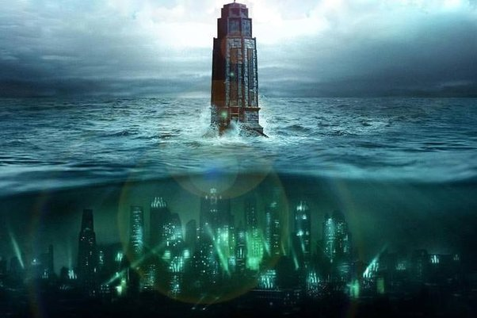
The crisis of utopia steered most of critical, political fiction to dystopia.
Dystopia, the reversal of utopia (effectively the bad place in Greek) has become prevalent, projecting current problems and anxieties into a bleak future. The notion dominates much of the popular imagination, especially in the science fiction genre.

Slide 14
Huxley's Brave New World , Orwell's 1984 , films such as Blade Runner and Brazil , and games like A Mind Forever Voyaging, Bioshock or Cyberpunk 2077 all evoke hellish cityscapes brilliantly, and warn us of political dangers. Interestingly, they too take place in fascinating urban environments.
Dystopias are pessimistic, and without fail deeply political and spatial in their critique of the status quo. They are never static, and in direct contrast to the end of history narrative which, in turn, so spectacularly and quickly collapsed.
They are also incredibly popular in video games; an increasingly influential and active element of popular culture.

Slide 15
Video Games and the Imagination of Utopia
Video gaming, as a medium, is defined by its ability to induce immersive experiences. As players suspend their disbelief they experience different, often impossible places and situations.
Such in-game sensations and thoughts are unavoidably transferred back into the real world, potentially taking part in its evolution.
Video games do not have to be useful in a measurable way. They are a popular art form with mainstream appeal, and thus in a position to enlighten, inspire, start discourses, and, in certain cases, spread ideas. It is in the nature and design sensibilities of video games to present convincing synthetic worlds and spaces, and enrich imaginations.

Slide 16
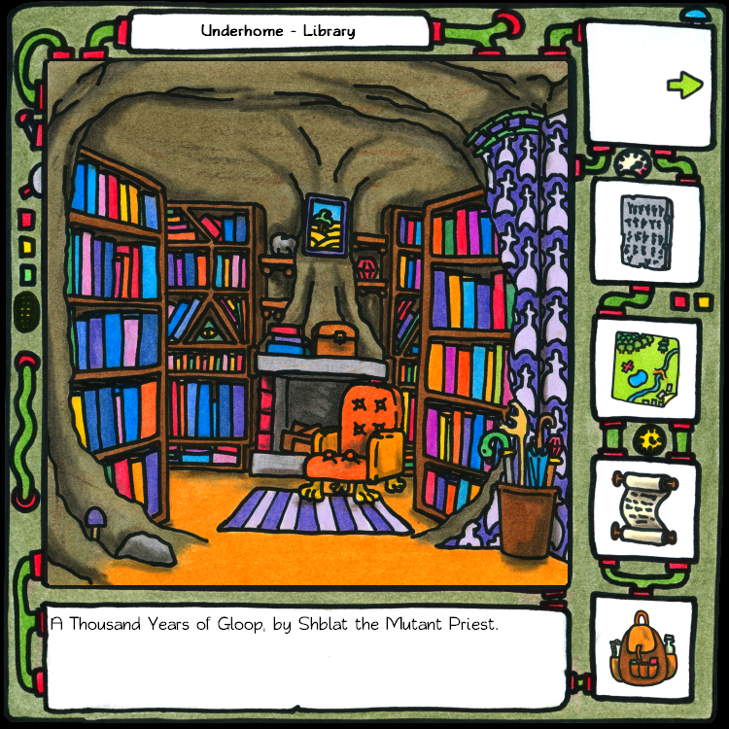
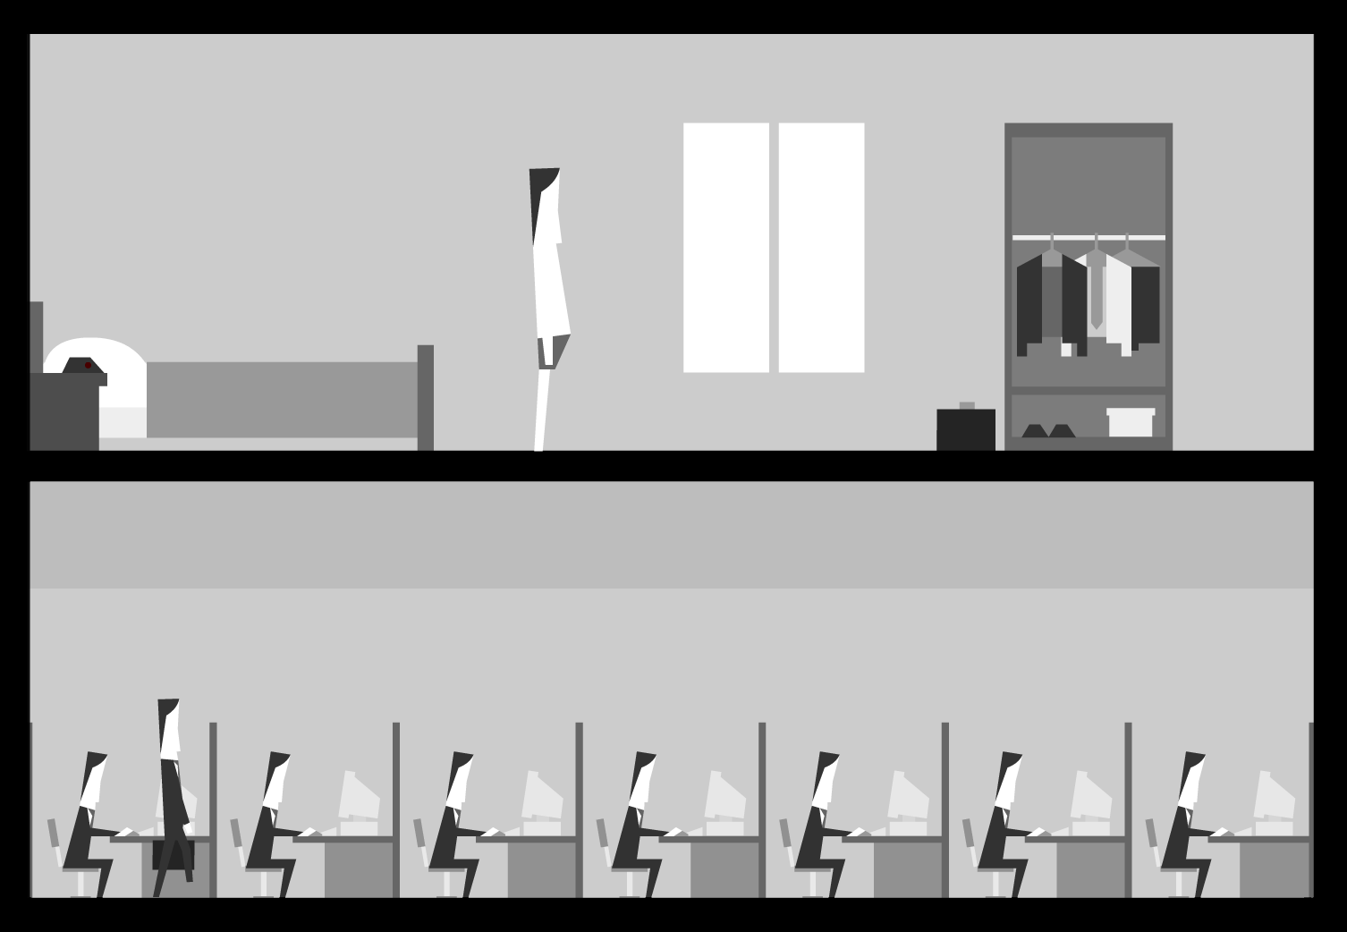
Games and utopian thought are compatible. The immersive, interactive, navigable urban worlds of gaming can inform the way we look at cities, life, and society as a whole. They can convey radical ideas, and imbue them with fully fleshed out (albeit digital) forms.

Slide 17
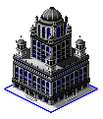
Playing and interacting in substantially different, dynamic, usually urban locales populated by clever automatons, and supported by simulation systems, sounds like something that would have been enthusiastically adopted by the utopian thinkers of the 19th century.
Such a powerful medium can indeed liberate or at the very least trigger our imagination to the point of picturing the unthinkable. Maybe not necessarily collectively, but at the very least on a minority level.
Alexander Galloway argues that all video games are, at a certain level, utopian projects anyway, due to them featuring worlds that pick and mix the laws and rules they are simulating. This freedom to shape rules is according to Galloway utopia's scaffolding.

Slide 18
Huizinga’s magic circle referred to social contexts where specific agreed upon rules distinguished one type of social space from another: the tennis-court, the chessboard, the arena, the temple, or, indeed, the video game screen.
But, just as a wedding ritual does not exclusively matter within the confines of the temple, and carries significance within civil society, so do gaming's virtual worlds influence people in the actual world.
Play moves out of the playground's boundaries just as effortlessly as Bioshock's critique of Ayn Rand sparked a wider discourse on ‘objectivism’. Even more emphatically, augmented reality game Pokémon GO had thousands hunting for cartoon monsters in actual cityscapes worldwide.

Slide 19
Video games are indeed a medium that can inspire novel thoughts, as well as a rare medium that demands the participation of audiences. Players of games have to think, react appropriately, and explore. They have to understand interlocking systems.
A game graces audiences with agency, teaches them its rules, trains them in its mechanisms, and then enforces attention and demands problem solving, thus further engaging and immersing them in its world.
Player choice is key in engineering the emotions that drive the game experience. This sense of agency amplifies player feelings, and piques their interest in their surroundings. Players engage with games and their settings on a deeper level as they learn to be attentive of their environments, and recognize the relationships governing them.

Slide 20
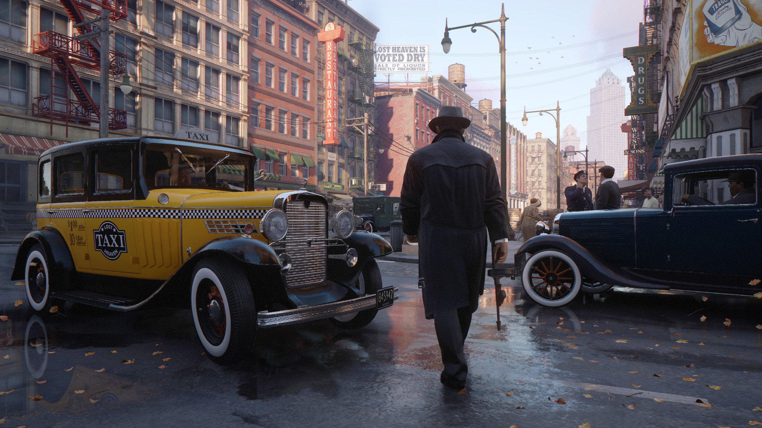
Video games (and their cities) provide us with a lens that transforms utopian text and two dimensional plans, the domain of the engineer and the architect, into interactive 3D digital spaces that are much closer to how we daily perceive physical space.
No specialized knowledge or map-reading skills are required to experience and understand virtual spaces, while the addition of layers of interactivity and simulation sub-systems further support the illusion of being there.

Slide 21
Video gaming medium can induce immersive experiences. And after players suspend their disbelief and experience virtual places, they can then transport their in-game sensations and thoughts into the real world, potentially taking part in the latter's evolution.
Games can become the building blocks for utopia. The LEGO bricks that may not necessarily nurture ideas by themselves, but will help express them – handily in a playful manner.
Video game cities do not have to be fake virtual; they can become potential virtual, and attempt to convincingly convey images of a different world.

Slide 22
Interestingly…
… video games also liberated play from the constraints of actual space. Their buildings and settlements can ignore physics, size restrictions, and costs. Vast expanses can be provided to players. Impossible gravity defying edifices, and irrational, fluid spaces can be conjured. Virtual architecture and urbanism do not have to adhere to the constraints of physics, laws, and the needs of actual people, but can still feel real.

Slide 23
Video games provide us with unending digital space to experiment with. Space that will never run out, can be arranged in virtually any way, and is supported by a menagerie of systems that make it convincing, and behave in ways we perceive as plausible.
What's more, and unlike previous utopian schemes, such systems can theoretically show the evolution of a proposed utopia. An immersive digital utopia does no longer have to be a static description, but a type of predictive tool that takes player choice into consideration. A game world can evolve along both deterministic, and procedural lines in an endlessly iterative fashion.

Slide 24
Games may be perfectly situated to let us imagine utopia and its spaces anew by combining spatial eloquence, persuasiveness, and interactivity, but it is the latter that could help explore even more intriguing directions without limiting imaginations to the pre-imagined by the author.
In-game building tools supported by clever systems, moral choices that can make or break utopia, online collaboration, and audience agency can bring dialectics and dynamism into the utopian discourse.
Perhaps video gaming's finest utopias can only be collaboratively, and organically imagined on massive servers by tens if not hundreds of thousands of active, engaged players.

Slide 25
The Very Basics of Virtual City Crafting
Every city has to make sense.
Realism leads to believability, and believability can lead to (spatial) immersion.
Do not think exclusively the architectural scale. Think like urban planners and geographers.
Let your city tell its story, and inspire your game, world, narrative, and level design.
Research your urbanism! You will find solutions you never knew you needed.
Remember that all urban centres are historical, societal constructs; thus dynamic, perpetual work in progress.

Slide 26
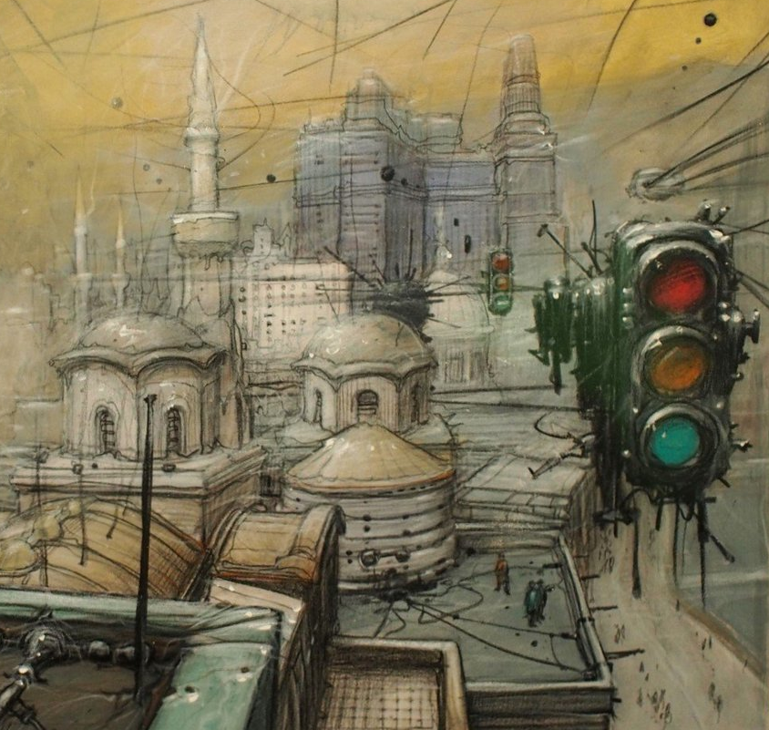
Focus on urban functions; they are the reasons cities exist–- urban functions are what cities do and are meant to do. Cities are built to facilitate and support them, and in turn evolve as those functions themselves evolve.
4Qs: When? Where? Why? How big?
All urban space has been planned.
Approach the city as a whole. Think from the general to the specific. Or don’t.
Cities are internally differentiated.
Urban infrastructure is the city’s skeleton.
All settlements have form and structure.
Consider arrivals/entrances, landmarks, and the boundaries of your cities.

Slide 27
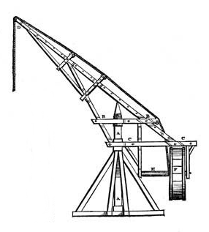
Crafting Urban History
Cities are the results of a historical, geographic process we have to simulate and showcase.
Civic evolution from village to town to city to metropolis to megalopolis; in parallel with political, economic, and technological evolution.
Cities can also devolve following wider historical changes.
Cities can be planned, and constructed ex novo.
History and society tend to build living worlds in layers.
Progress and evolution never stop. Cities are always under construction.

Slide 28
A Simplified Game City How-To
Choose an existing or historical city, and abstract it to a manageable level. Research. Identify defining characteristics. Apply generalization / simplification -- abstract it.
Examples: Assassin’s Creed Syndicate, Gabriel Knight.
Heavily modify and/or combine existing or historical cities; mix their elements, and disguise them.
Examples: Mafia III, and Terry Pratchett's Ankh-Morpork.
Create a city from scratch. Start by asking ‘Where? When? Why? And How big?’. Decide what makes it memorable. List its functions. Craft & layer its history. Come up with a rough map of the city and its environs, and work from the general to the specific. Plan land uses, and consider the urban structure. Populate it. Make it interesting & believable.
Examples: Midgar, Rubacava, City 17, Rapture.

Slide 29
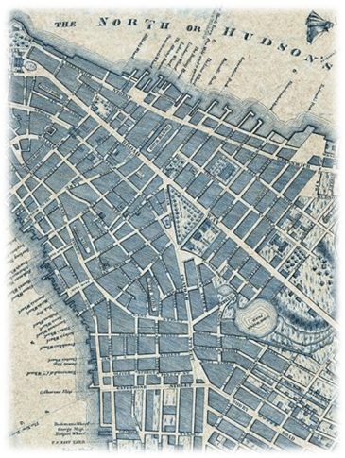
Contact information:
email: konstantinos.dimopoulos@gmail.com
twitter: @gnomeslair
site: https://www.game-cities.com
facebook: https://www.facebook.com/GameCities
linkedin: https://www.linkedin.com/in/konstantinos-dimopoulos-42b62b4/
Thank you!

